Slide 1
Propositional Logic
Discrete Mathematics

Slide 2
1.2 Propositional Equivalences
Tautology
- A compound proposition that is always true no matter what the truth values of the propositions that occur in it is called tautology.
Contradiction
-A compound proposition that is always false is called contradiction.
Logical Equivalence
-Compound propositions that have the same truth values in all possible cases are called logically equivalent.

Slide 3
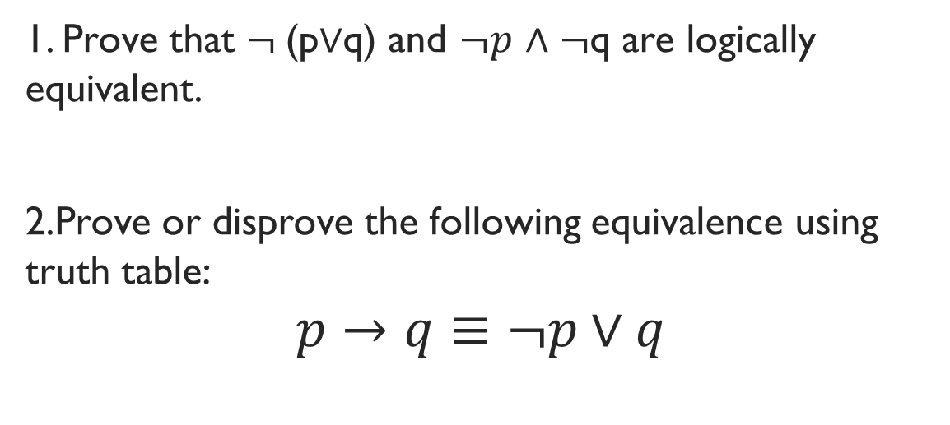
Logical Equivalence
1. Prove that $¬$(p$∨$q) and $¬p$ $∧$ $¬$q are logically equivalent.
2.Prove or disprove the following equivalence using truth table:
$$p→q≡¬p∨q$$

Slide 4
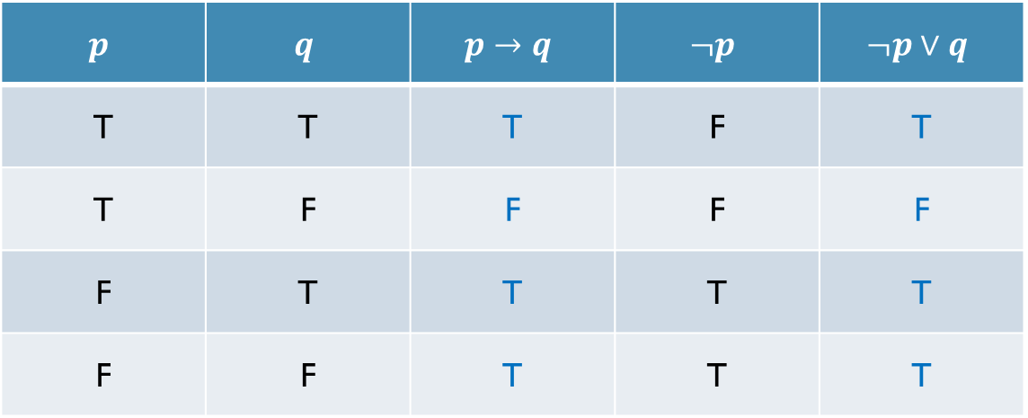

$p→q≡¬p∨q$???
$$p$$ | $$q$$ | $$p→q$$ | $$¬p$$ | $$¬p∨q$$
T | T | T | F | T
T | F | F | F | F
F | T | T | T | T
F | F | T | T | T

Slide 5

Exercise
Prove that p $∨$ (q $∧$r) and (p $∨$ q) $∧$ (p $∨$r) are logically equivalent.

Slide 6
Another way to verify equivalence
We remember some important equivalences
We use them to verify any given equivalence

Slide 7


Important logical equivalences
Identity
Domination
$$p∧T≡p$$
$$p∨F≡p$$
$$p∨T≡T$$
$$p∧F≡F$$

Slide 8


Important logical equivalences
Idempotent
Double negation
$$p∧p≡p$$
$$p∨p≡p$$
$$¬\left(¬p\right)≡p$$

Slide 9


Important logical equivalences
Commutative
Associative
$$p∨q≡q∨p$$
$$p∧q≡q∧p$$
$$\left(p∨q\right)∨r≡p∨\left(q∨r\right)$$
$$\left(p∧q\right)∧r≡p∧(q∧r)$$

Slide 10

Important logical equivalences
Distributive
$$p∨\left(q∧r\right)≡\left(p∨q\right)∧\left(p∨r\right)$$
$$p∧\left(q∨r\right)≡\left(p∧q\right)∨(p∧r)$$
Notes:
Show $\left(a∧b\right)∨\left(c∧d\right)$here:
(a v (c $∧$ d)) $∧$ (b v (c $∧$ d))
(a v c) $∧$ (a v d) $∧$ (b v c) $∧$ (b v d)

Slide 11

Important logical equivalences
De Morgan’s law
$$¬\left(p∧q\right)≡¬p∨¬q$$
$$¬\left(p∨q\right)≡¬p∧¬q$$

Slide 12


Important logical equivalences
Absorption
Negation
$$p∨\left(p∧q\right)≡p$$
$$p∧\left(p∨q\right)≡p$$
$$p∨¬p≡T$$
$$p∧¬p≡F$$

Slide 13



Important logical equivalences
Conditional
Contrapositive
$$p→q≡¬p∨q$$
$$p→q≡¬q→¬p$$
Biconditional
$$p↔q≡\left(p→q\right)∧(q→p)$$

Slide 14

Example: Prove that $¬\left(p→q\right)≡p∧¬q$
Rosen, page 26, example 6

Slide 15


Exercise: Prove that$¬\left(p→q\right)≡p∧¬q$
$$¬\left(p→q\right)$$
$≡¬(¬p∨q)$ [Conditional]
$≡¬\left(¬p\right)∧¬q$ [ De Morgan’s Law]
$≡p∧¬q$ [Double Negation]

Slide 16
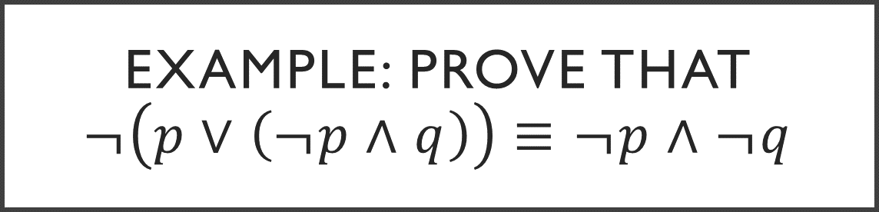
Example: Prove that $¬\left(p∨\left(¬p∧q\right)\right)≡¬p∧¬q$
Rosen, page 26, example 7

Slide 17

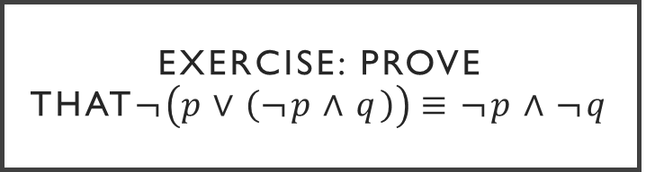
Exercise: Prove that$¬\left(p∨\left(¬p∧q\right)\right)≡¬p∧¬q$
$$¬(p∨(¬p∧q))$$
$≡¬(p)∧¬(¬p∧q)$
$≡¬p∧$ $[¬(¬p)∨¬q]$
$≡¬p∧(p∨¬q$)
$$≡(¬p∧p)∨(¬p∧¬q\text{)}$$
$$≡F∨(¬p∧¬q\text{)}$$
$$≡(¬p∧¬q\text{)}$$

Slide 18
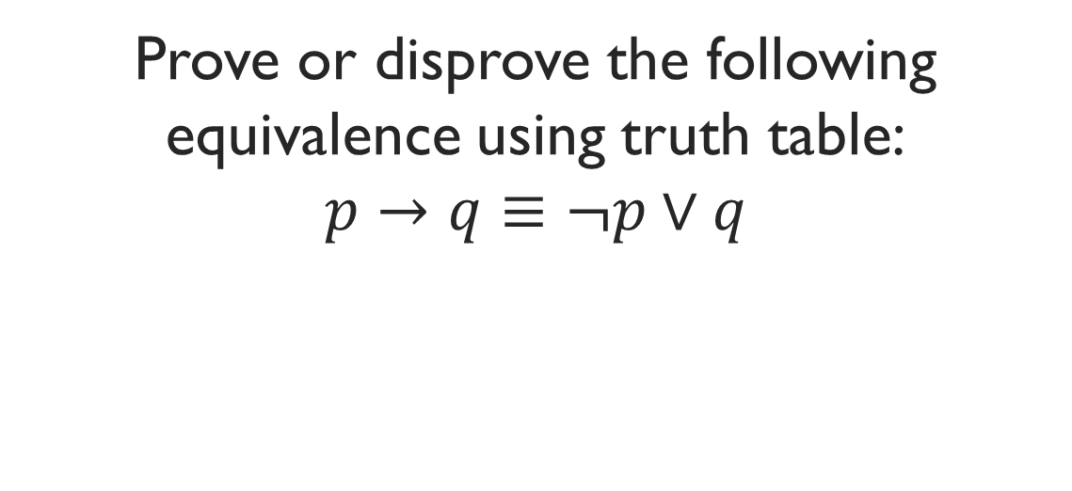
Example: Prove that $\left(p∧q\right)→(p∨q)$ is a tautology
Rosen, page 27, example 8

Slide 19


Exercise: Prove that$\text{(}\text{p}\text{∧}\text{q}\text{)→(}\text{p}\text{∨}\text{q}\text{) }\text{is} \text{a} \text{tautology}$
$$(p∧q)→(p∨q)$$
$$≡¬(p∧q)∨(p∨q)$$
$$≡\left(¬p∨¬q\right)∨\left(p∨q\right)$$
$≡(¬p∨p)∨(q∨¬q$)
$$≡T∨T$$
$$≡T$$

Slide 20
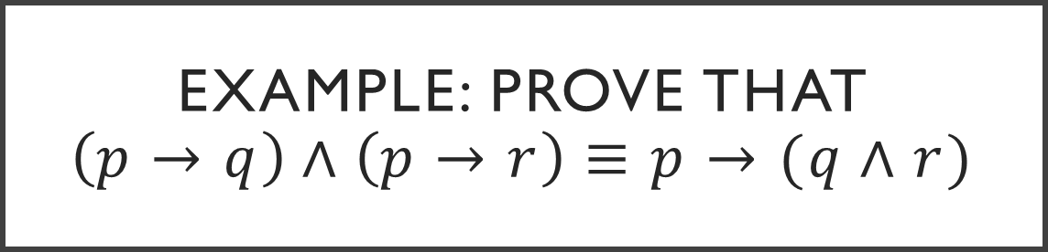
Example: Prove that $\left(p→q\right)∧\left(p→r\right)≡p→(q∧r)$
Rosen, page 29, exercise 22

Slide 21

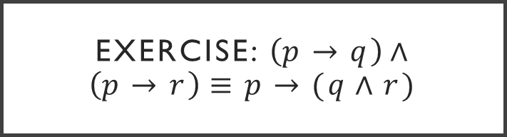
Exercise: $\left(p→q\right)∧\left(p→r\right)≡p→(q∧r)$
$$\left(p→q\right)∧\left(p→r\right)$$
$$≡(¬p∨q)∧(¬p∨r)$$
$$≡¬p∨\left(q∧r\right)$$
$$≡p→(q∧r)$$

Slide 22
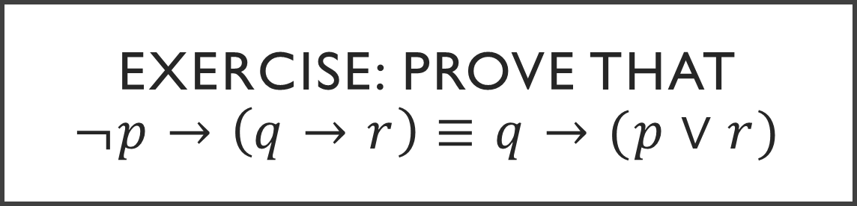
Exercise: Prove that $¬p→\left(q→r\right)≡q→(p∨r)$
Rosen, page 29, exercise 26

Slide 23
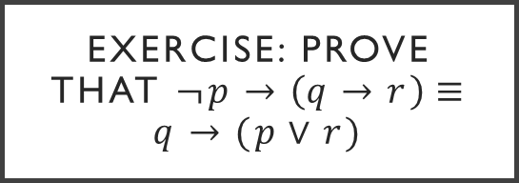
Exercise: Prove that $¬p→\left(q→r\right)≡q→(p∨r)$
$¬p→\left(q→r\right)$
$≡¬\left(¬p\right)∨(q→r)$
$≡p∨(q→r)$
$≡p∨(¬q∨r)$
$≡p∨¬q∨r$
$≡¬q∨p∨r$
$≡¬q∨(p∨r)$
$≡q→(p∨r)$
Rosen, page 29, exercise 26

Slide 24

Exercise: Prove that $¬\left(p↔q\right)≡p↔¬q$
Rosen, page 28, exercise 16

Slide 25
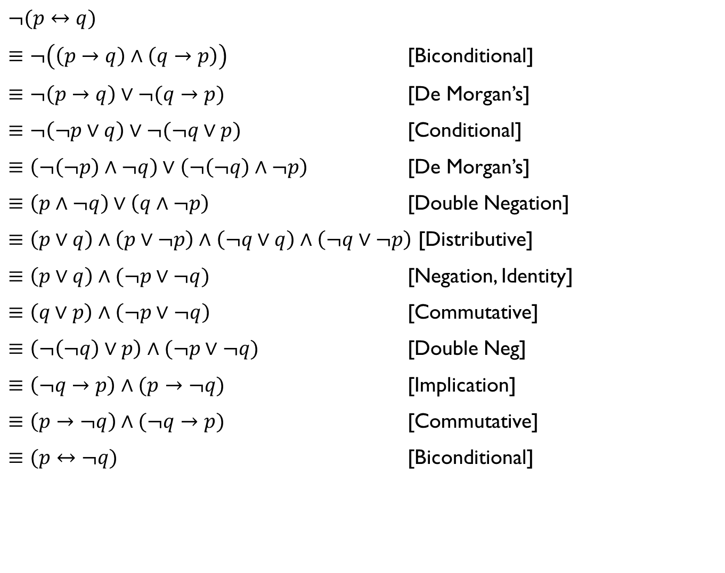
$¬(p↔q)$
$≡¬\left(\left(p→q\right)∧\left(q→p\right)\right)$ [Biconditional]
$≡¬\left(p→q\right)∨¬(q→p)$ [De Morgan’s]
$≡¬\left(¬p∨q\right)∨¬(¬q∨p)$ [Conditional]
$≡\left(¬\left(¬p\right)∧¬q\right)∨\left(¬\left(¬q\right)∧¬p\right)$ [De Morgan’s]
$≡\left(p∧¬q\right)∨\left(q∧¬p\right)$ [Double Negation]
$≡\left(p∨q\right)∧\left(p∨¬p\right)∧\left(¬q∨q\right)∧\left(¬q∨¬p\right)$ [Distributive]
$≡\left(p∨q\right)∧(¬p∨¬q)$ [Negation, Identity]
$≡\left(q∨p\right)∧\left(¬p∨¬q\right)$ [Commutative]
$≡\left(¬\left(¬q\right)∨p\right)∧(¬p∨¬q)$ [Double Neg]
$≡\left(¬q→p\right)∧(p→¬q)$ [Implication]
$≡\left(p→¬q\right)∧(¬q→p)$ [Commutative]
$≡(p↔¬q)$ [Biconditional]

Slide 26
Example: Prove that $\left(p→q\right)∧\left(q→r\right)→(p→r)$ is a tautology
Rosen, page 29, exercise 29

Slide 27
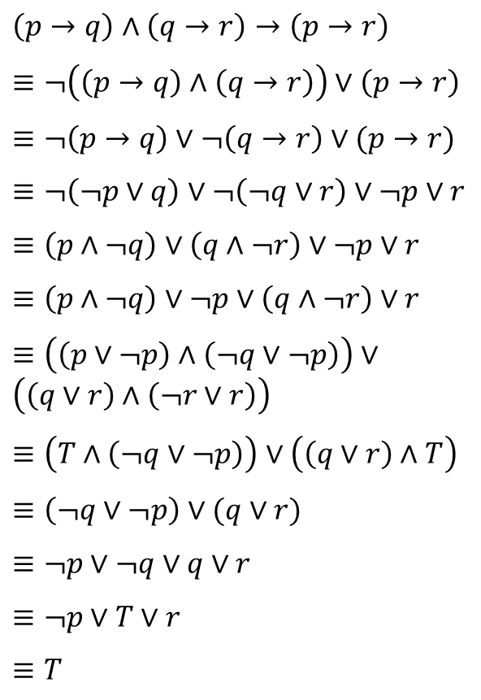
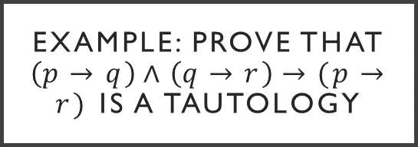
Example: Prove that $\left(p→q\right)∧\left(q→r\right)→(p→r)$ is a tautology
$\left(p→q\right)∧\left(q→r\right)→\left(p→r\right)$
$≡¬\left(\left(p→q\right)∧\left(q→r\right)\right)∨\left(p→r\right)$
$≡¬\left(p→q\right)∨¬\left(q→r\right)∨(p→r)$
$≡¬\left(¬p∨q\right)∨¬\left(¬q∨r\right)∨¬p∨r$
$≡\left(p∧¬q\right)∨\left(q∧¬r\right)∨¬p∨r$
$≡\left(p∧¬q\right)∨¬p∨\left(q∧¬r\right)∨r$
$≡\left(\left(p∨¬p\right)∧\left(¬q∨¬p\right)\right)∨\left(\left(q∨r\right)∧\left(¬r∨r\right)\right)$
$≡\left(T∧\left(¬q∨¬p\right)\right)∨\left(\left(q∨r\right)∧T\right)$
$≡\left(¬q∨¬p\right)∨(q∨r)$
$≡¬p∨¬q∨q∨r$
$≡¬p∨T∨r$
$≡T$
Rosen, page 29, exercise 29

